Slide 1

32nd International Economic Conference of Sibiu IECS 2025
***
«Lucian Blaga» University of Sibiu (RO) - Sibiu, 30th May 2025
***
The role of Artificial Intelligence in the reforms of the recruitment processes of researchers and professors in the Higher Education Sector: a theoretical proposal applicable to the Italian Case Study
***
Pollifroni Massimo et al.; 2025

Slide 2
Background
The Bologna Process was born in 1999 as an intergovernmental collaboration agreement in the higher education sector. The initiative was launched with the Bologna Conference at the conference of European Higher Education Ministers, signed in Bologna in June 1999 and inspired by the previous meeting of the Ministers of France, Germany, Italy and the United Kingdom in 1998 (Sorbonne Declaration 1998).

Slide 3
Background
The Bologna Process’s objective was precisely to build a European Higher Education Area that was based on principles and criteria shared between the participating countries.
Subsequently, the inspiring principles of the reform were implemented by the various countries adhering to the reform.

Slide 4
Background
In Italy, the reform was started by Law 30/12/2010, n. 240, “Regulations regarding the organization of universities, academic staff and recruitment, as well as delegation to the Government to encourage the quality and efficiency of the university system”.
Law no. 240/2010 therefore represents the starting point of the reform launched in Italy.

Slide 5
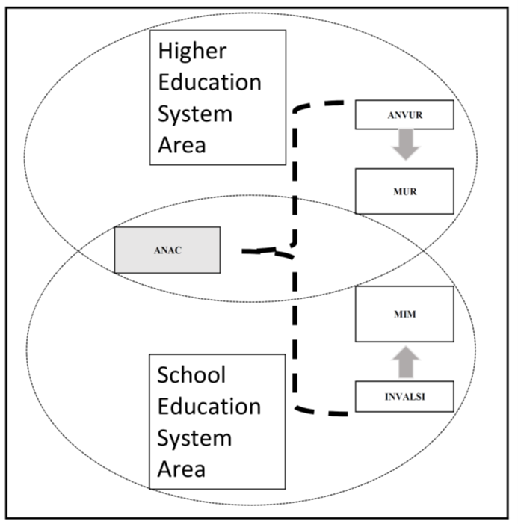
Background: Actors engaged in the model applied to the Italian Higher and School Education Systems.

Slide 6
Background
Fifteen years after the entry into force of the law, on 20th September 2024 the Minister of University and Research signed Decree no. 1591 which establishes the working group that will deal with the new reform of Law no. 240/2010.
Among the issues that the new reform will have to address, there is the recruitment of researchers and professors, who are divided into three distinct groups: researchers, associate professors and full professors. The three categories follow different recruitment processes that present numerous areas of improvement that are being studied by the working group established by Decree no. 1591.

Slide 7
Research aims
The aim of the paper is to illustrate the current recruitment processes and subsequently provide a theoretical proposal for their improvement relating to two e-Government models called Citizen to Government and Employee to Government (C2G and E2G).
The proposal will also seek to strengthen the orientation of recruitment processes towards the themes of good performances, administrative transparency and impartiality, today included in the neologism Open Government and since 1948 enshrined in Article No. 97 of the Italian Constitution.
To achieve these objectives, the theoretical model proposed in the paper will make use of current e-Government processes integrated by the new application of the innovative technologies, such as Artificial Intelligence (AI).

Slide 8
Research Methodology
The paper follows a research methodology approach very close to the “Aprioristic Theory” (Freadman et al., 1992; Haspelmath, 2012; Rothbard, 1962), in which the knowledge precedes the experience.
This type of knowledge is based on reason and logic and can be expressed through propositions that are considered true by virtue of their structure and not by their correspondence with experience.

Slide 9
The current model

Slide 10
HES recruitment path: discussion on the current model
The following average data emerge from the table (years: 2018, 2021 and 2023):
the ratio of winners to candidates for the NSC is 56,71%;
the ratio between winners at local Competitions and winners at the NSC is 16,48%;
the ratio between winners at local Competitions and candidates at the NSC is 9,34%;
although female candidates for the NSC are fewer than male candidates, female performance is found to be better than male performance.

Slide 11
HES recruitment path: discussion on the current model
From what has been exposed, it emerges that the system has difficulty absorbing the NSQ winners and only 9 out of 100 NSQ candidates become professor (Full professor or Associate professor).
This consideration is the basis for extending the validity of the NSC from 6 to 12 years, as previously reported and the difficulty absorbing the NSQ winners will gradually make local Competitions more crowded, with the increasing risk of administrative appeals.
Finally, it is important to point out that these extensions of the times for entering service in the various academic qualifications inevitably lead to an increase in the average age of the personnel in service (see Table 2) and “(…) in the analysis of the distribution by age group, Italy is also the only one of the main European countries in which the majority of university professors are at least 50 years old (…)” (ANVUR, 2023)

Slide 12
HES recruitment path: discussion on the current model

Slide 13
HES recruitment path: discussion on the current model
However, the current model of recruitment in the HES has nevertheless provided, with the NSQ, greater objectivity of judgment on the evaluation of candidates at a national level.
The greatest critical issues are present, however, in local competitions, where:
The number of candidates increases and therefore the risk of litigation increases (administrative appeals, recusals of commissions, etc.);
At a local level, the risk of conflict of interest between candidates and evaluator commissioners is higher;
The regulations for local competitions have allowed, on some occasions, the introduction of evaluation criteria that have transformed the local competition into a "tailor-made suit" to privilege some candidates at the expense of others;
Finally, the main (unwritten) criteria of local academic selection have been those of self-referentiality and "belonging" and not those of meritocracy and inclusiveness.

Slide 14
HES recruitment path: the theoretical model
To overcome the critical issues of the current model, the theoretical one proposed in the document introduces a series of innovations, including:
the abolition of local competitions;
the transformation of the NSQ (National Scientific Qualification, a non-comparative procedure for the evaluation of research, dedicated to aspiring AP and FP) into the NRPHE (National Procedure for Recruitment in Higher Education, a comparative procedure for the evaluation of research, teaching, institutional and third mission activities, dedicated to aspiring R, AP and FP);
the use of current e-government platforms integrated with AI, in place of evaluation commissions.

Slide 15
The theoretical model

Slide 16
The role of AI in the theoretical model (main functions)
Check the documentation submitted by candidates to the NRPHE (for R, AP and FP).
Evaluate the candidates' qualifications (for research, teaching, institutional and third mission activities), according to models shared with the reference scientific areas of the 190 Competition Sectors.
Generate the related operational algorithms from the shared models.
Generate the candidates' areas of expertise.
Generate the final rankings (for R, AP and FP).

Slide 17
Conclusions 1/3
There is an awareness that the motivations underlying the proposed NRPHE model could be divisive, as it is not only oriented towards meritocratic criteria, but also towards the inclusiveness of all academic actors present in the Higher Education System.
Alternately, a model oriented only to a meritocratic criterion (or to “other” criteria) will inevitably lead to an exacerbation of academic polarization: in other words, the strongest academic groups will always be stronger at the expense of the less structured ones, which will be increasingly marginalized from every type of activity.

Slide 18
Conclusions 2/3
Although the NRPHE theoretical model formulated in the document for the reform of the higher education system's recruitment processes may presumably not be fully shared by the academic community itself, it is still possible at this point to highlight two important conclusions:
these reform processes will be irreversible and unstoppable;
and the positive effects for the new generations of teachers and students will be visible in the medium-long term.

Slide 19
Conclusions 3/3
Alternatively, proceeding with the reform of law no. 240/2010 without addressing the current critical issues in the recruitment model of the Higher Education system would be like stating that “(...) everything must change, so that nothing changes (...)”, which is the synthesis of a phrase taken from the novel “Il Gattopardo”, written by Giuseppe Tomasi di Lampedusa in 1958 about the Sicily of the Italian Risorgimento (1860-1910).

Slide 20

Thanks for your attention!
Contact:
Massimo Pollifroni
E-mail: massimo.pollifroni@unito.it

