Slide 1

AUTHORS:
SIDOR VANESA LUISA, "AUREL VLAICU" UNIVERSITY OF ARAD, INTERDISCIPLINARY RESEARCH INSTITUTE
BILȚI RALUCA SIMINA, "AUREL VLAICU" UNIVERSITY OF ARAD, FACULTY OF ECONOMIC SCIENCES
RUSU CORINA MARIA, "AUREL VLAICU" UNIVERSITY OF ARAD, FACULTY OF ECONOMIC SCIENCES
BOȚOC CLAUDIU, WEST UNIVERSITY OF TIMIŞOARA, FACULTY OF ECONOMICS AND BUSINESS ADMINISTRATION
PRESENTER:
RESEARCH ASSISTANT
SIDOR VANESA LUISA
THE EVOLUTIONARY LANDSCAPE OF SMES INNOVATION AND POLICY: A BIBLIOMETRIC ANALYSIS OF GLOBAL RESEARCH OUTPUT

Slide 2

AIM OF THE STUDY
  quantitative mapping of the global scientific landscape regarding SMEs placed in the context of innovation and regulatory frameworks;
  which are the countries with the greatest contribution in this field;
  what is the chronological evolution of the researched field;
  key institutions as well as other relevant data regarding global production on this topic;

Slide 3



Research Methodology
The study was conducted using the Web of Science database. A query was built based on three groups of keywords:
  “SME*” OR “small and medium enterprise*” OR “small business*”
  “government policy” OR “public policy” OR “regulatory framework” OR “institutional changes” OR “policy instruments”
  “innovation” OR “disruptive technology”
The query returned 317 records, which were extracted for the analysis without additional filtering .
The dataset was further analyzed in VOSviewer through:
  a co-authorship analysis by countries, using a minimum threshold of 1 document per country and a maximum of 10 countries per document
  a co-authorship analysis by organizations, using a minimum threshold of 1 document per organization and a maximum of 10 organizations per document
  a keyword co-occurrence analysis over time (all keywords), using a minimum occurrence threshold of 1 per keyword
  additionally, the country-level data extracted from VOSviewer was exported to Excel, where a pivot table was created to analyze citations per country

Slide 4
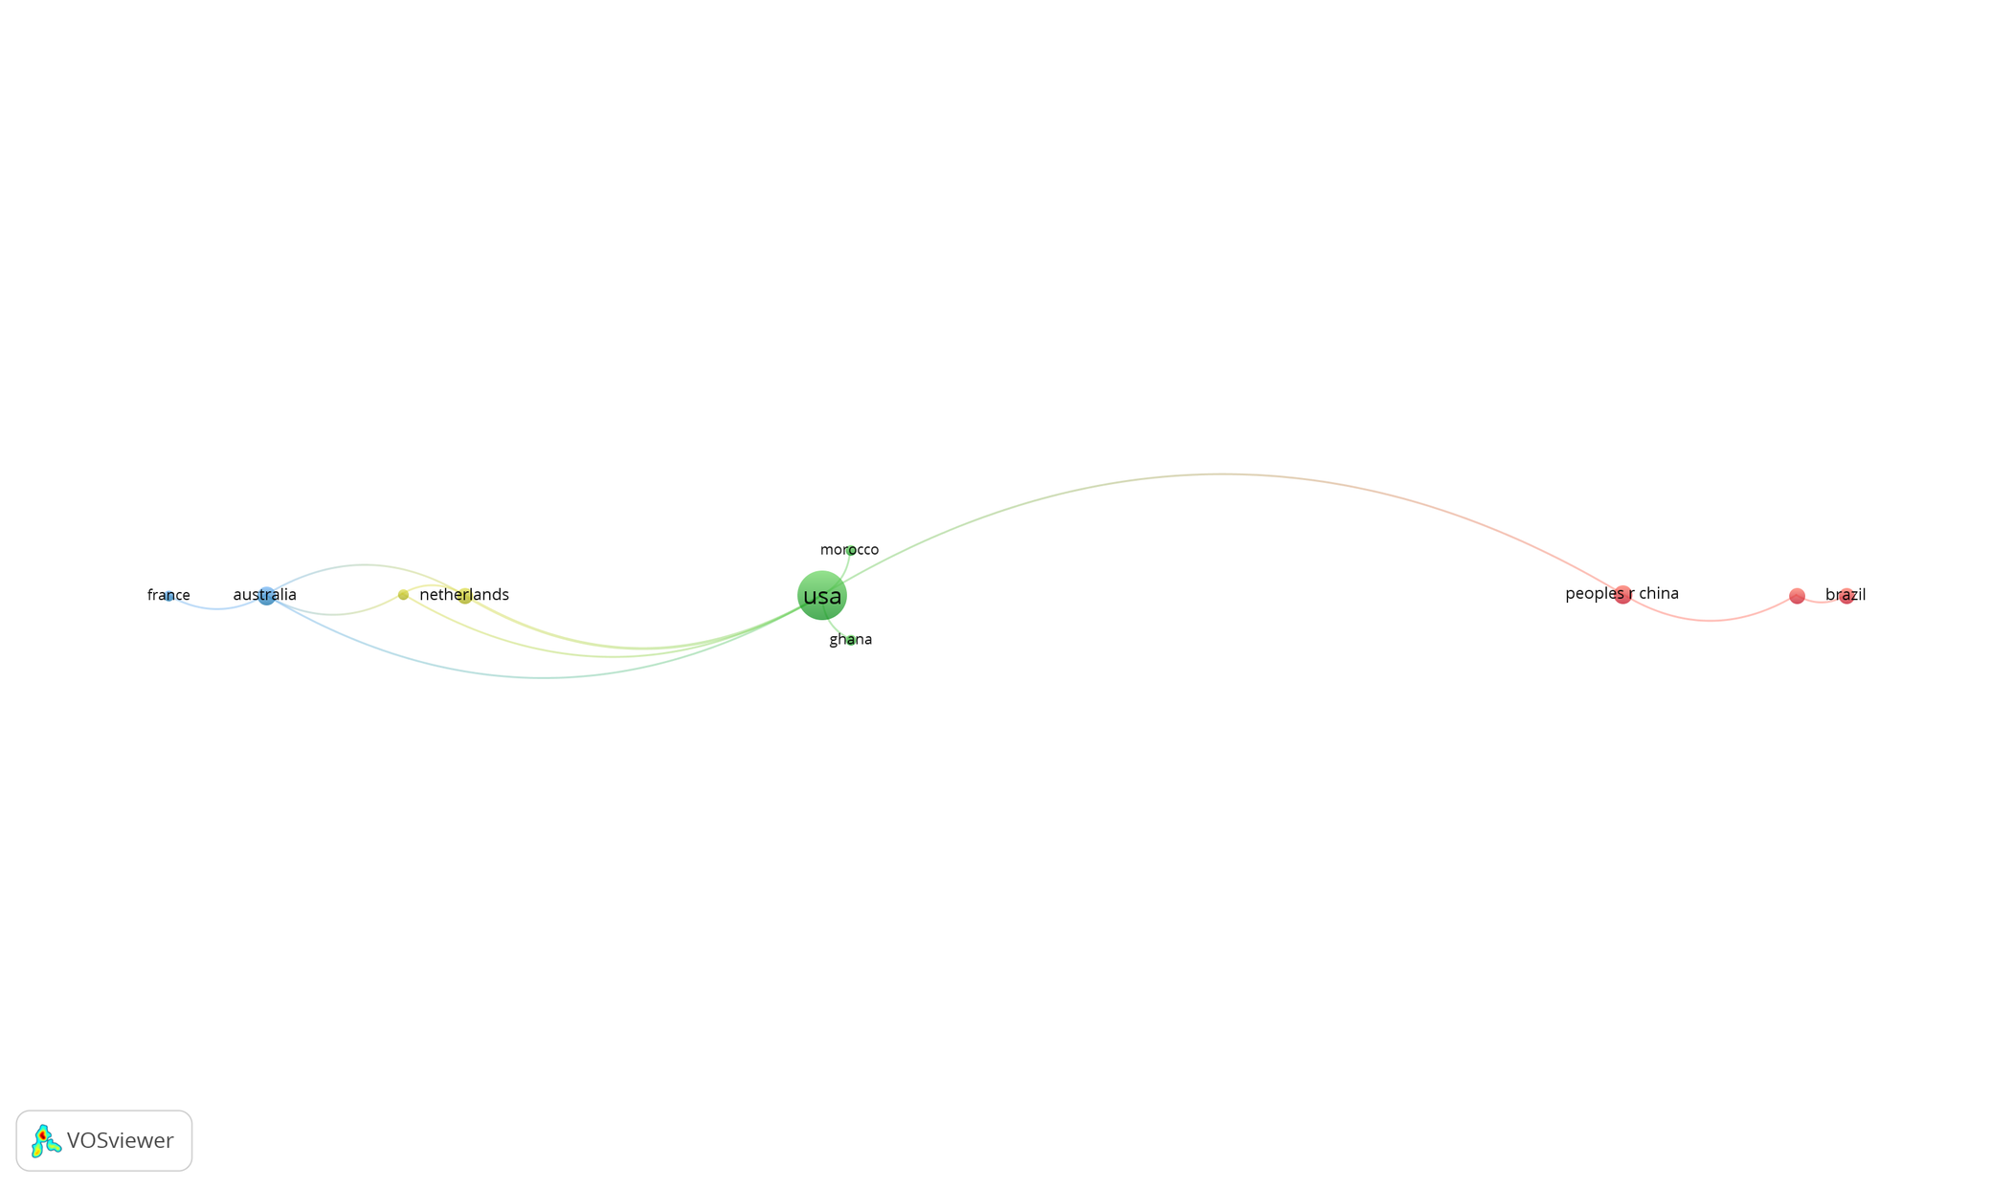
RESULTS
02

Slide 5
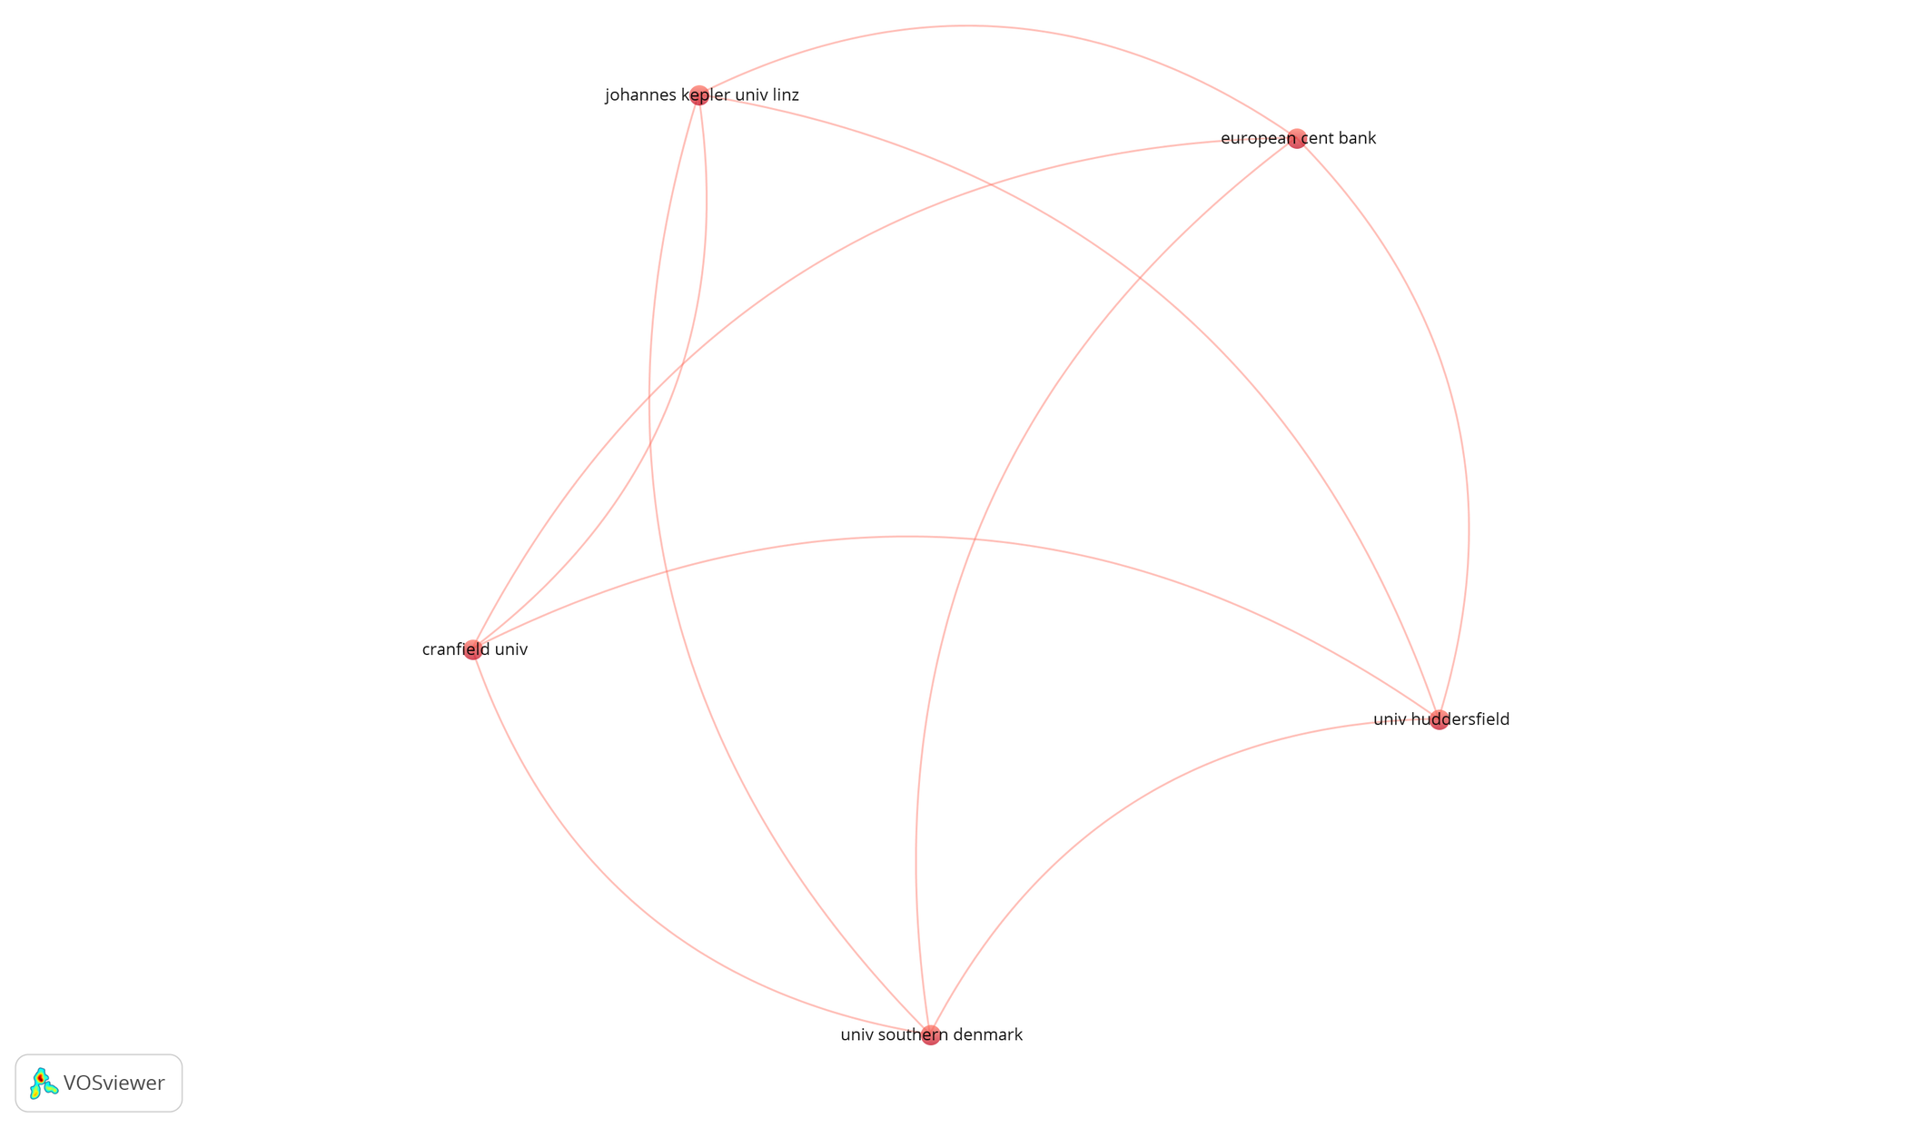
RESULTS
02

Slide 6
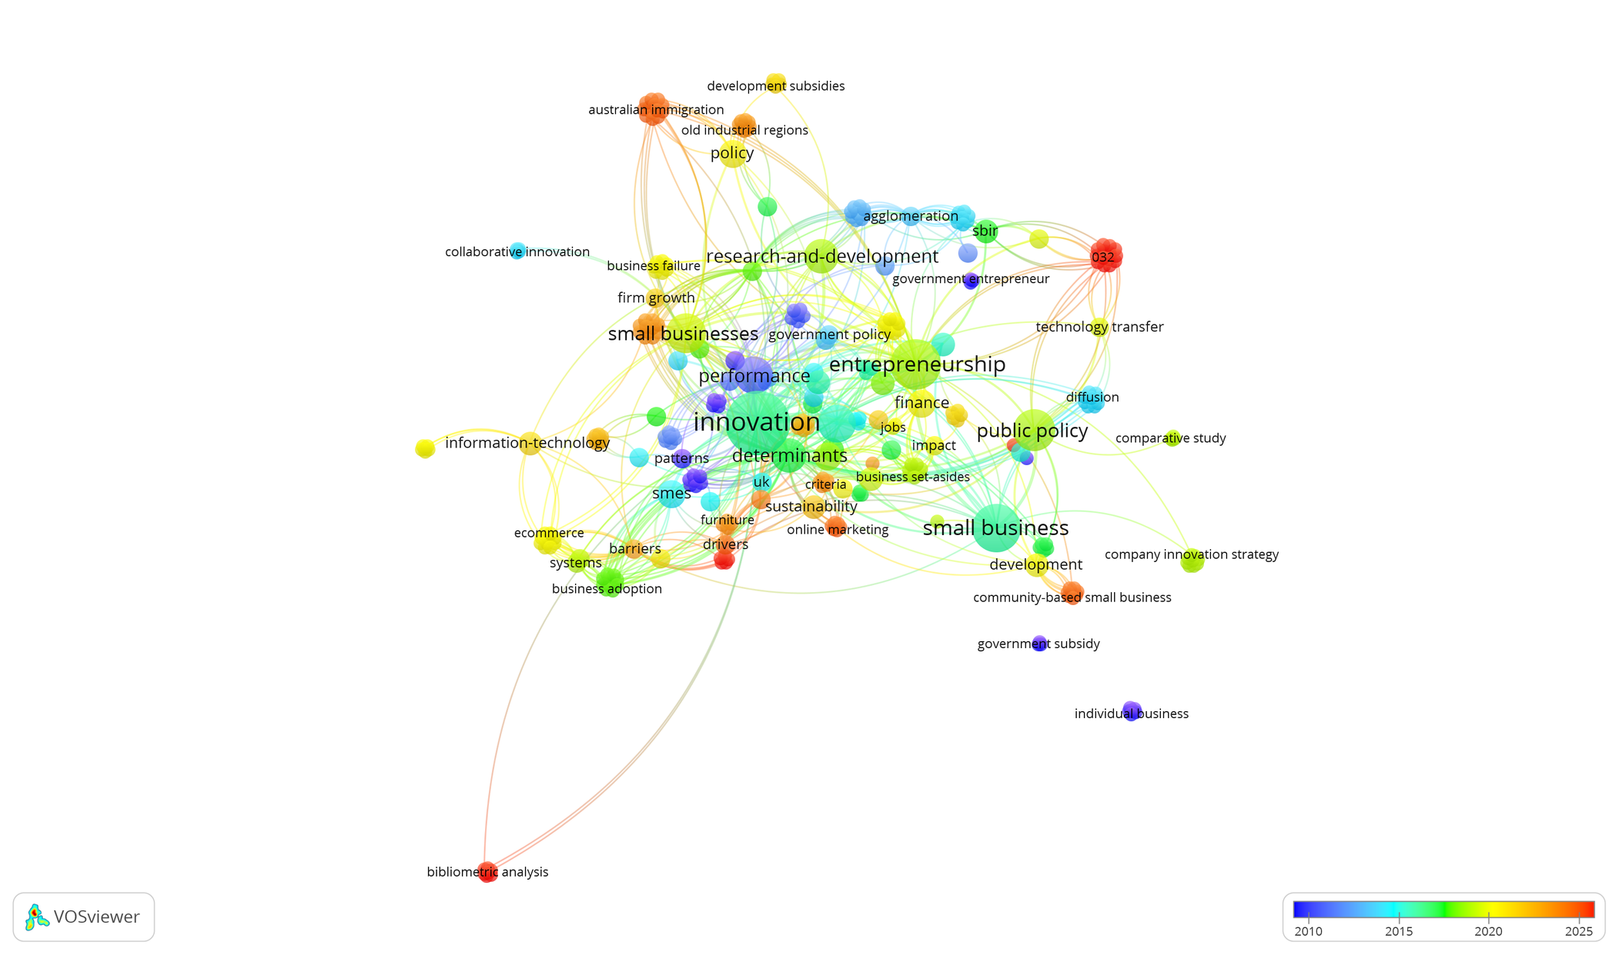
RESULTS
02

Slide 7

RESULTS
Countries | Citations
usa | 557
netherlands | 100
australia | 94
italy | 79
peoples r china | 25
ghana | 23
canada | 17
brazil | 9
france | 6
morocco | 3
Total general | 913

Slide 8

Thank You

